Slide 1



FInC Flow: Fast and Invertible k × k Convolutions for Normalizing Flows
THESIS DEFENSE
Aditya V Kallappa
2019702012
aditya.kallappa@research.iiit.ac.in
International Institute of Information Technology, Hyderabad, India

Slide 2
Outline
Prerequisites – Generative AI
Normalizing Flows
Convolution – A Linear Transformation
Inverse of convolution
Inverse Techniques
FInC Flow – Our Work
GPU implementation

Slide 3
Generative AI
Generative AI refers to a class of artificial intelligence algorithms that have the capability to generate new content, such as text, images, or other forms of data, based on patterns and information present in the training data

Slide 4
Generative AI
Generative AI refers to a class of artificial intelligence algorithms that have the capability to generate new content, such as text, images, or other forms of data, based on patterns and information present in the training data
Text: GPT-3, Chat-GPT, PaLM, Llama etc.

Slide 5
Generative AI
Generative AI refers to a class of artificial intelligence algorithms that have the capability to generate new content, such as text, images, or other forms of data, based on patterns and information present in the training data
Text: GPT-3, Chat-GPT, PaLM, Llama etc.
Images: GAN, StyleGAN, DeepCream

Slide 6
Generative AI
Generative AI refers to a class of artificial intelligence algorithms that have the capability to generate new content, such as text, images, or other forms of data, based on patterns and information present in the training data
Text: GPT-3, Chat-GPT, PaLM, Llama etc.
Images: GAN, StyleGAN, DeepCream
Art: DALL-E, Aiva
Audio: GANs, Normalizing Flows, VAE models

Slide 7
Generative AI
Involves around 4 types of generative models:
GAN(Generative Adversarial Networks): The generator creates synthetic data, while the discriminator evaluates whether the generated data is real or fake.
VAE(Variational Auto Encoders): Consists of an Encoder which compresses the data and a Decoder which tries to get the original data from a compressed encoded data
Normalizing Flows: Generates data by simply transforming a Normal Distribution by a series of invertible and differentiable functions
Diffusion Models: These models transform a simple and known distribution (e.g., Gaussian noise) into a complex and high-dimensional distribution that matches the characteristics of the target data.

Slide 8
Why Normalizing Flows
Use of bijective and differentiable allows models for easy generation and manipulation of data
Exact Likelihood: Unlike all the other models, we can actually compute the probability distribution of the data
Flexible and Explicit Density Modeling
Versatile data generation

Slide 9
Why Normalizing Flows
Use of bijective and differentiable allows models for easy generation and manipulation of data
Exact Likelihood: Unlike all the other models, we can actually compute the probability distribution of the data
Flexible and Explicit Density Modeling
Versatile data generation
But the generation of samples can be extremely slow

Slide 10
Our Contributions
We develop a system/model which
has a fast parallel inversion algorithm with running time O(nk²) (n is height and width of the input image and k is kernel size)
masks the minimal amount of learnable parameters in a layer
gives better sampling time comparable to other k × k convolution-based models on real-world benchmarks.

Slide 11
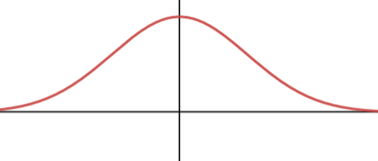
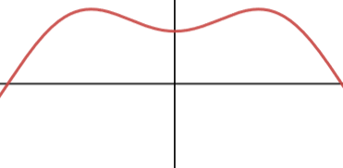
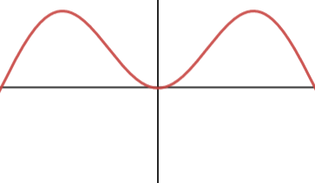
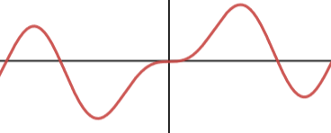
Normalizing Flows
f_{i}’s are both differentiable and invertible
f₁
f₂
f₃
f_{K}
z₀
z₁
z₂
z_{K}
. . .
f₁⁻¹
f₂⁻¹
f₃⁻¹
f_{K}⁻¹

Slide 12


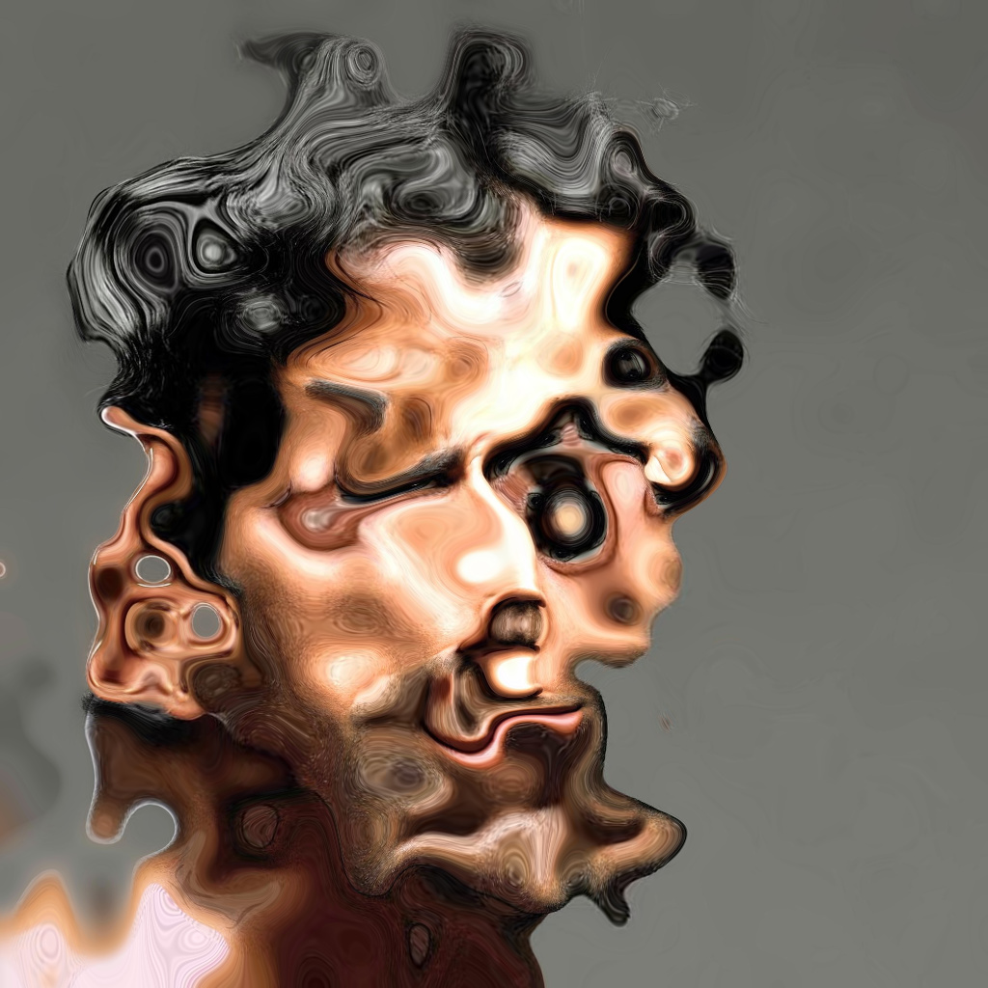

Normalizing Flows
f₁
f_{K-2}
f_{K-1}
f_{K}
. . .
f₁⁻¹
f_{K-2}⁻¹
f_{K-1}⁻¹
f_{K}⁻¹

Slide 13
Normalizing Flows
f_{i}’s are both differentiable and invertible
f₁
f₂
f₃
f_{K}
z₀
z₁
z₂
z_{K}
. . .
f₁⁻¹
f₂⁻¹
f₃⁻¹
f_{K}⁻¹

Slide 14
Normalizing Flows NLL Derivation

Slide 15
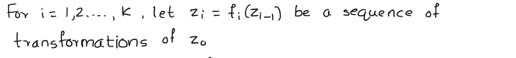
Normalizing Flows NLL Derivation

Slide 16

Normalizing Flows NLL Derivation

Slide 17
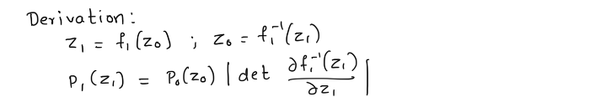

Normalizing Flows NLL Derivation

Slide 18
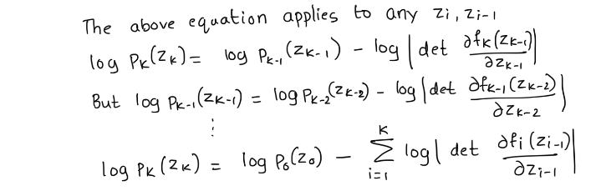
Normalizing Flows NLL Derivation

Slide 19
Convolution
*
=

Slide 20
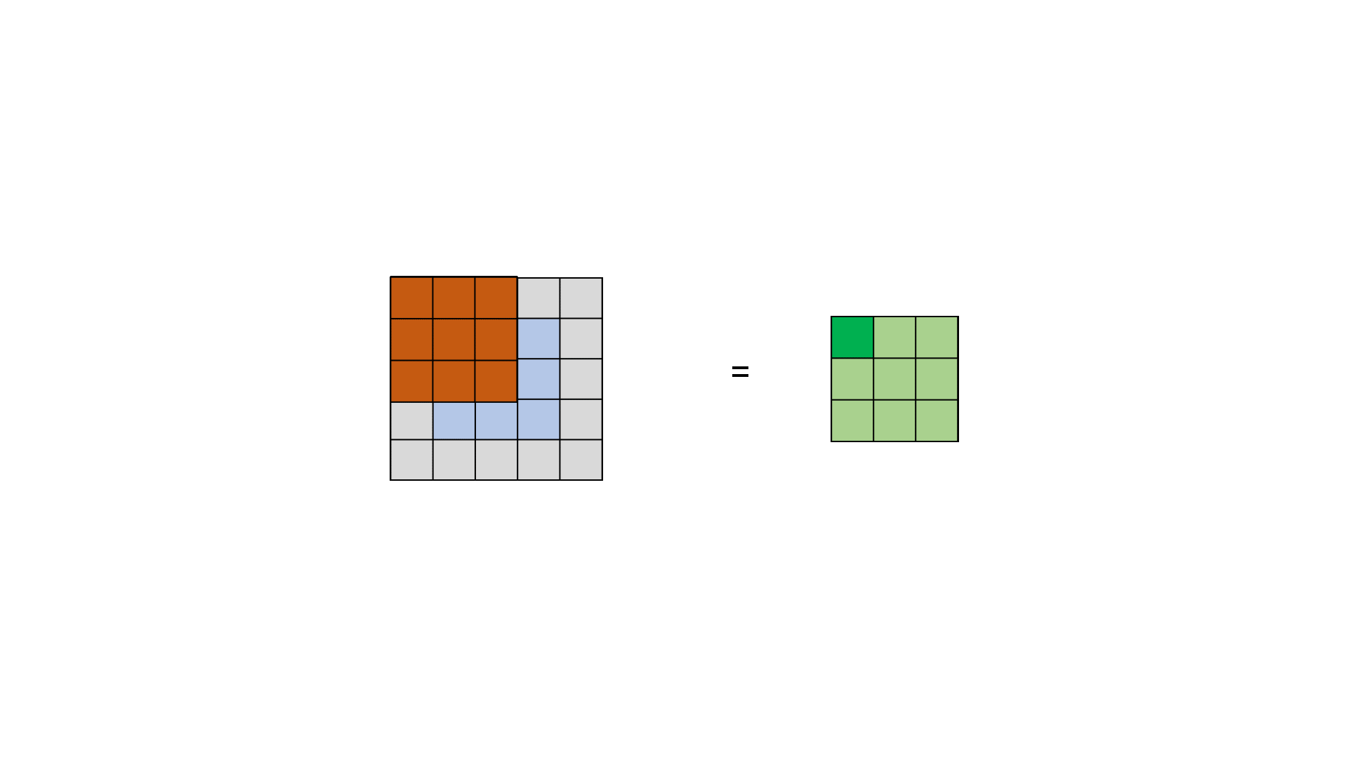
Convolution

Slide 21



Convolution – Padding, Stride, Step
Padding = 0, Stride = 1
Padding = “same”, Stride = 1
Padding = 0, Stride = 2
Image Credits: https://hannibunny.github.io/mlbook/neuralnetworks/convolutionDemos.html

Slide 22
Notations
n – Height and Width of an image
H – Height of an image
W – Width of an image
k – Height and Width of a convolution filter (kernel)
k x k – Size of a kernel
C – Number of channels
* - Convolution operator

Slide 23
Convolution – A Linear Transformation
At each step of the convolution, k x k multiplications occur
In other words, every value in the output can be thought of as a linear function of kernel weights and subset of input (that is, input values in the corresponding window)
In fact, we can say input is being linearly transformed by a matrix (M) referred to as Convolution Matrix

Slide 24
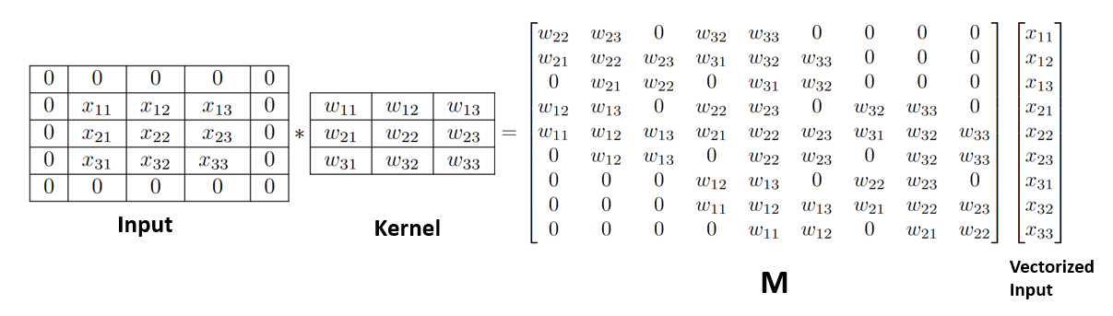
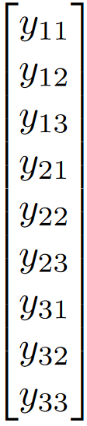
Convolution – A Linear Transformation
=
Vectorized output
Fig. General Convolution – A linear transformation. M, the Convolution Matrix

Slide 25
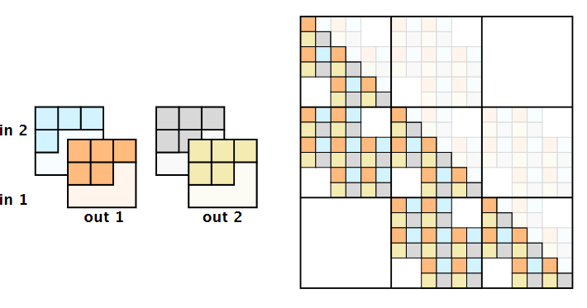
Inverse Techniques
Emerging Flows
Leverages the fact that convolution is associative
Two Auto regressive Convolutions are chained
Each of the Auto regressive Convolution is chosen so that M is triangular
Inverse Time is O(n²k²)
^{K}₂^{∗ (K}₁ ^{∗ X) = (K}₂ ^{∗ K}₁^{) ∗ X}
Credits: Hoogeboom, E., Van Den Berg, R., and Welling, M. (2019). Emerging convolutions for generative normalizing flows. In International Conference on Machine Learning, pages 2771–2780. PMLR.

Slide 26
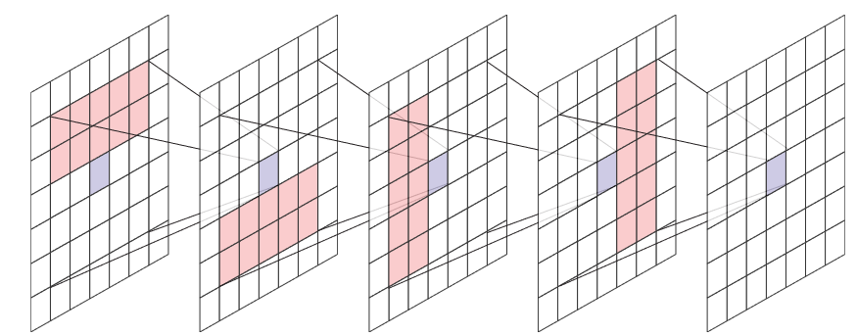
Convolution Techniques
MACOW: Masked Convolutional Flow
Leverages the fact that convolution is associative
Four Masked Convolutions are chained
Inverse Time is O(nk²)
Credits: Ma, X., Kong, X., Zhang, S., and Hovy, E. (2019). Macow: Masked convolutional generative flow. Advances in Neural Information Processing Systems, 32.

Slide 27
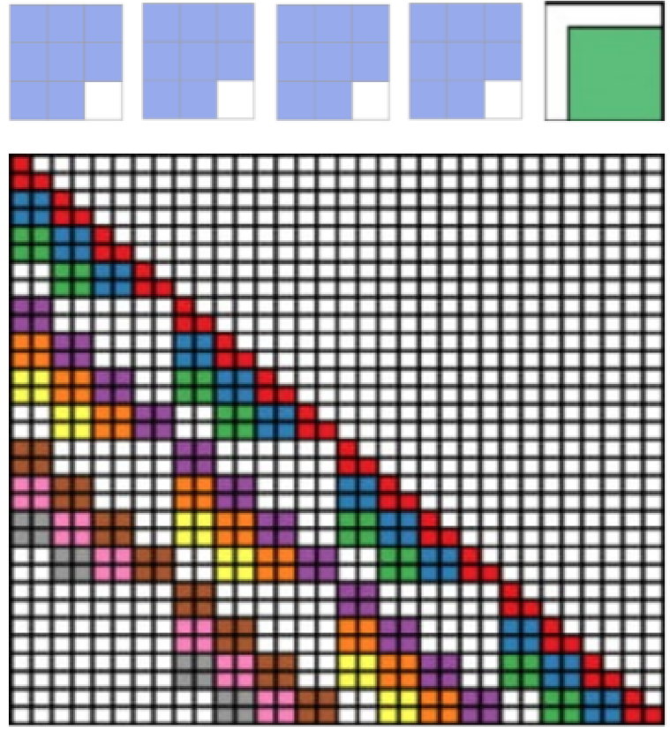
Inverse Techniques
CInC Flow
Padding the input is done so that the resulting M is triangular
Very minimal amount of masking required
Requires only 1 filter per convolution
Inverse Time is O(n²k²)
Credits: Nagar, S., Dufraisse, M., and Varma, G. (2021). CInc flow: Characterizable invertible 3 x 3 convolution. In The 4th Workshop on Tractable Probabilistic Modeling.

Slide 28
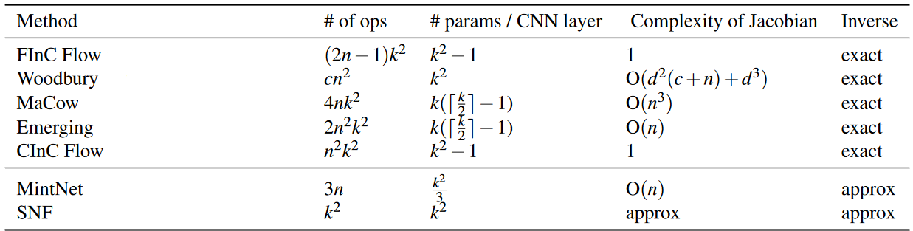
Inverse Techniques
We observe that techniques mask much of the kernel values and thus resulting in needing more kernels
We observe that the inverse time is O(n²k²)
Can we do better?
n x n – Size of the image; c – Number of Channels; k x k – Filter Size; d – Intermediate Latent Dimension Space

Slide 29
Top Left Convolutions
*
=

Slide 30

Top Left Convolutions

Slide 31
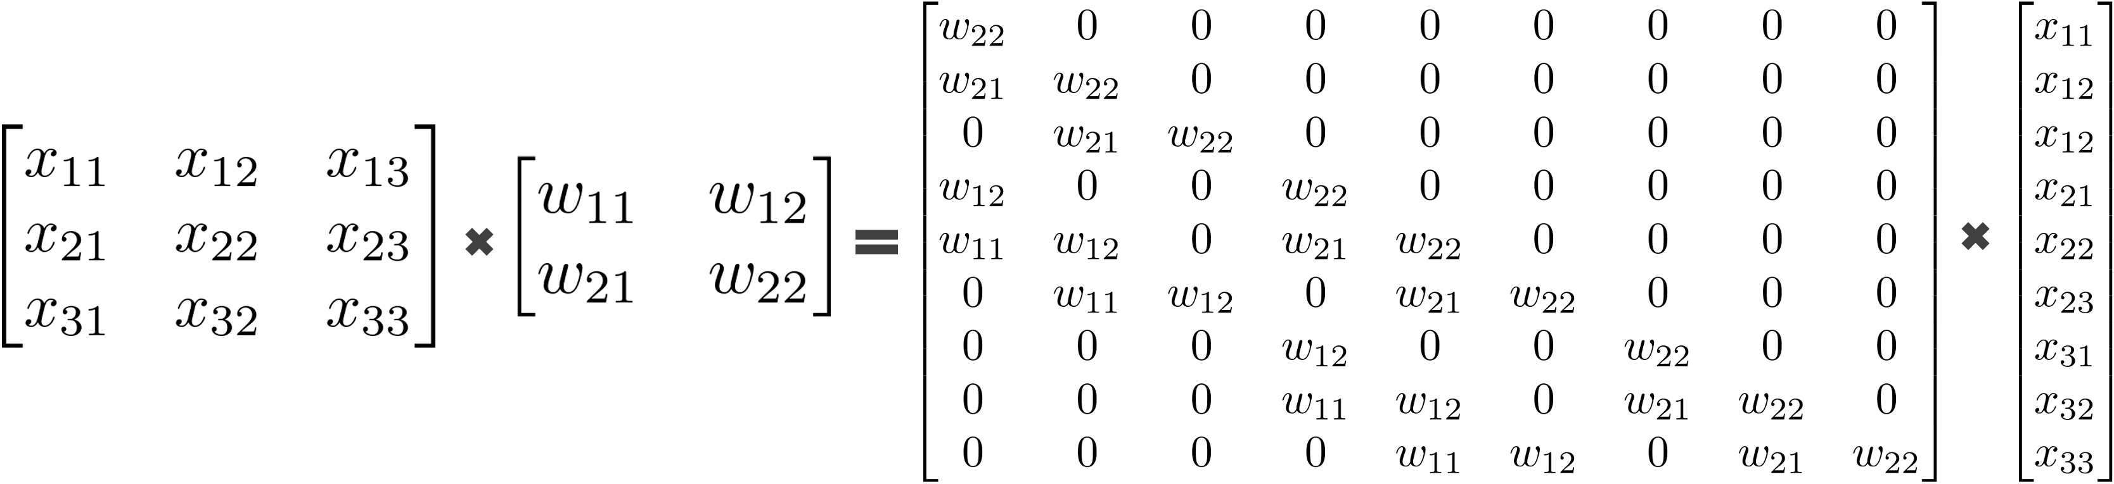
Top Left Convolutions
*
=

Slide 32
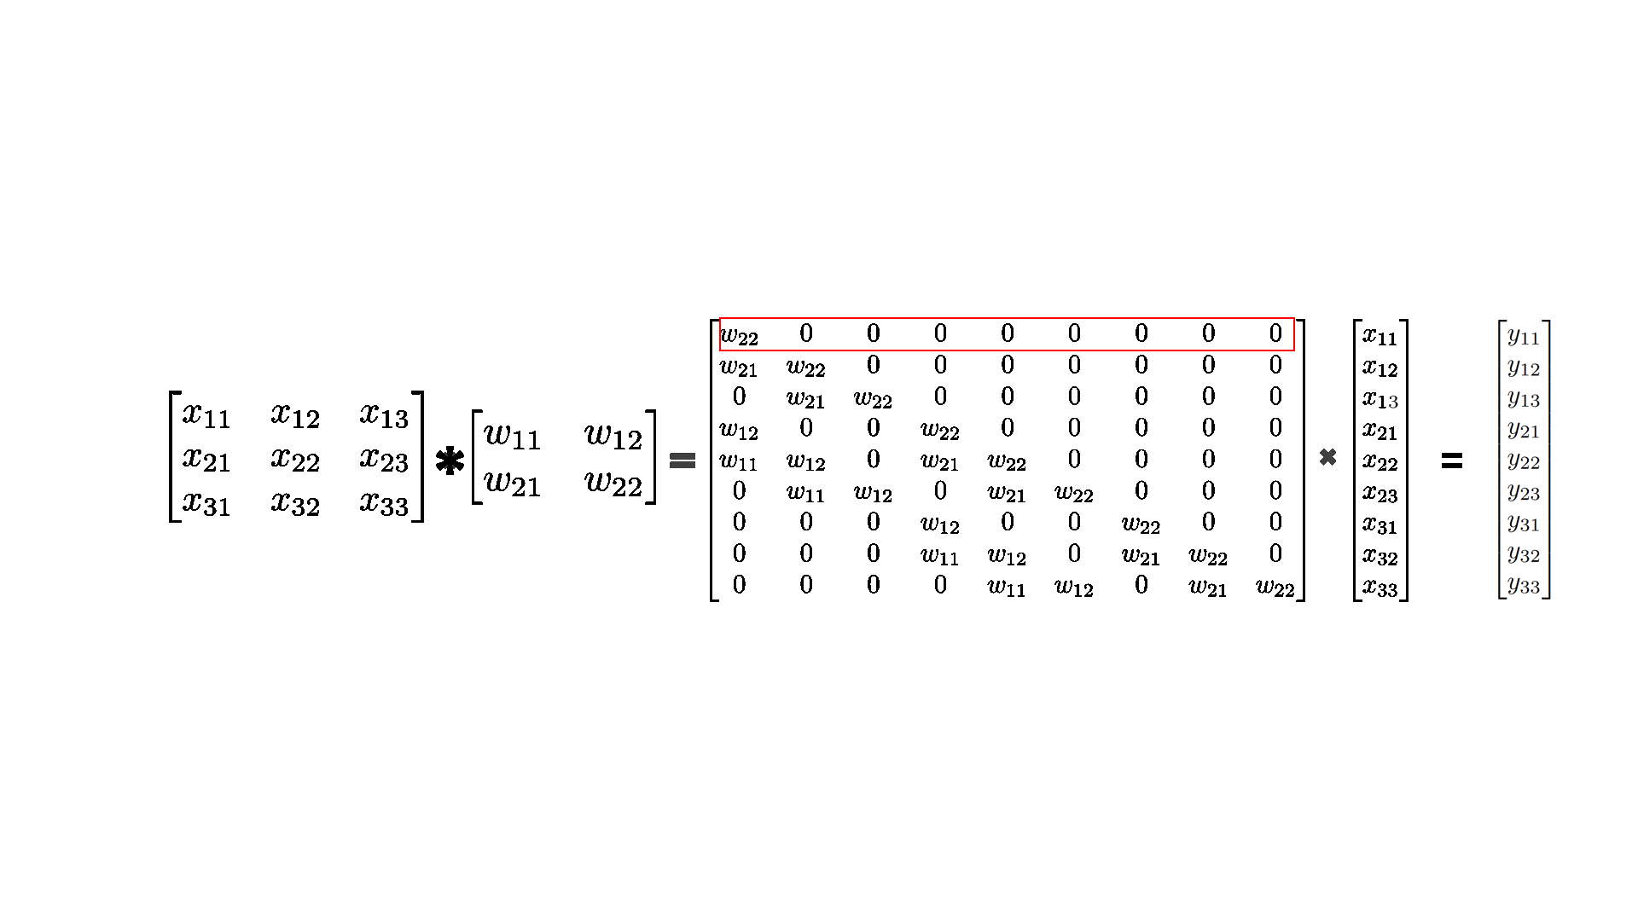
Top Left Convolutions

Slide 33
Top Left Convolutions
*
=

Slide 34
Top Left Convolutions
*
=

Slide 35
Top Left Convolutions
*
=

Slide 36
Top Left Convolutions
*
=

Slide 37
Top Left Convolutions
*
=

Slide 38
Top Left Convolutions
*
=

Slide 39
Top Left Convolutions
*
=

Slide 40
Top Left Convolutions
*
=

Slide 41
Top Left Convolutions
*
=

Slide 42
Top Left Convolutions

Slide 43
Top Left Convolutions
*
=

Slide 44
Top Left Convolutions
*
=

Slide 45
Top Left Convolutions
*
=

Slide 46
Top Left Convolutions
*
=

Slide 47
Top Left Convolutions
*
=

Slide 48
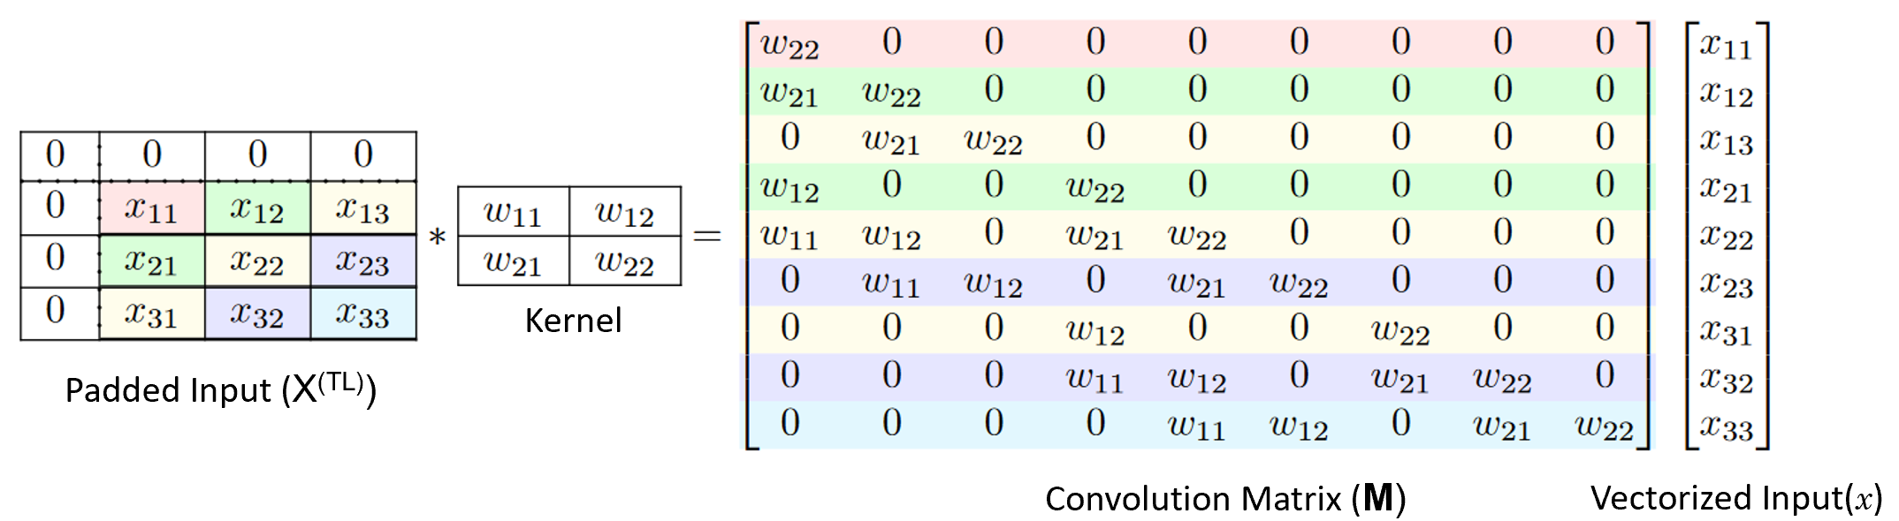
Top Left Convolutions

Slide 49
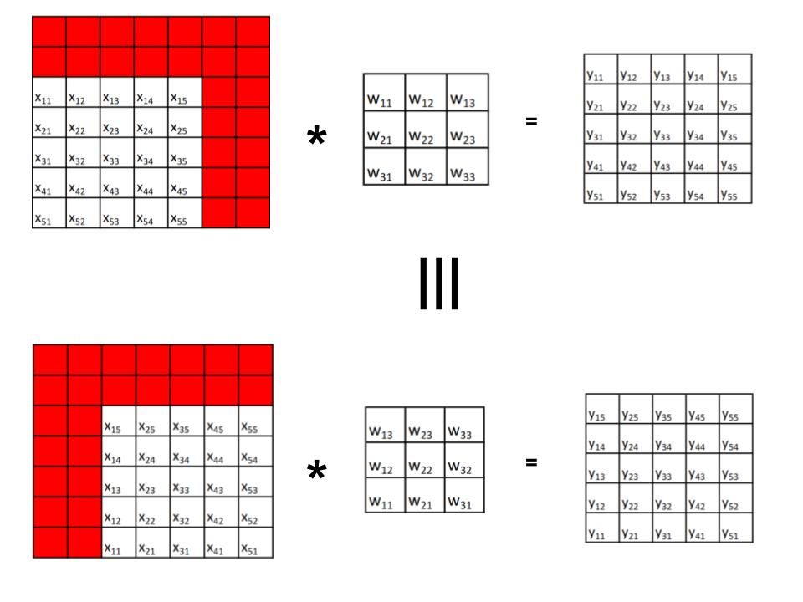
FInC Flow – Our Approach

Slide 50
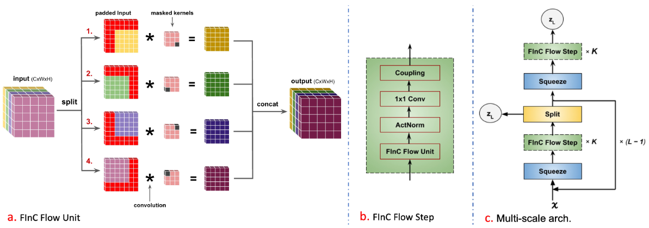
FInC Flow – Our Approach
FInC Flow
Padding the input is done so that the resulting M is triangular
Very minimal amount of masking required
Inverse Time is O(nk²)

Slide 51
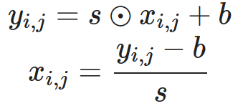
FINC Flow – Architecture
ActNorm
Performs an affine transformation of the activations using a scale and bias parameter per channel, similar to batch normalization.
Batch Normalization is not generally used because for large images, we need to train with batch_size = 1 and it creates a problem

Slide 52
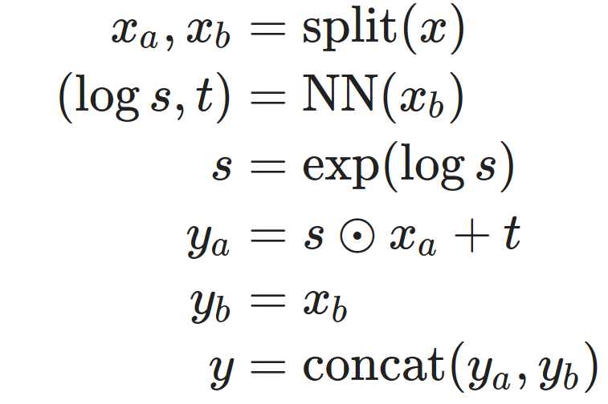
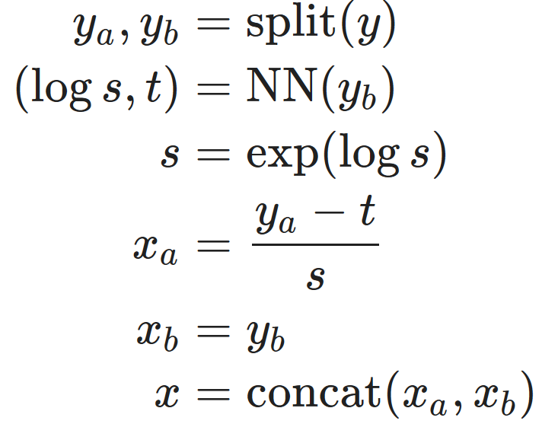
FINC Flow – Architecture
Affine Coupling Layer
A powerful reversible transformation where the forward function, the reverse function and the log-determinant are computationally efficient

Slide 53
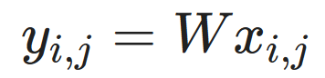
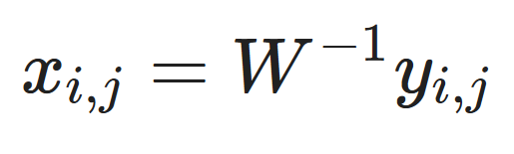
FINC Flow – Architecture
Invertible 1x1 Convolution
To incorporate a permutation along the channel dimension, we include a trainable invertible 1 × 1 convolution layer to generalize the permutation operation as:

Slide 54
Bijective Functions
Split
Input is split into two halves across the channel dimension. We retain the first half and a function parameterized by first half transform the second half.
The transformed second half is modeled as Gaussian samples, are the latent vectors.
Squeeze
This function/layer reduces the feature dimension by total four, two across the height dimension and two across the width dimension resulting in increases the channel dimension by four

Slide 55
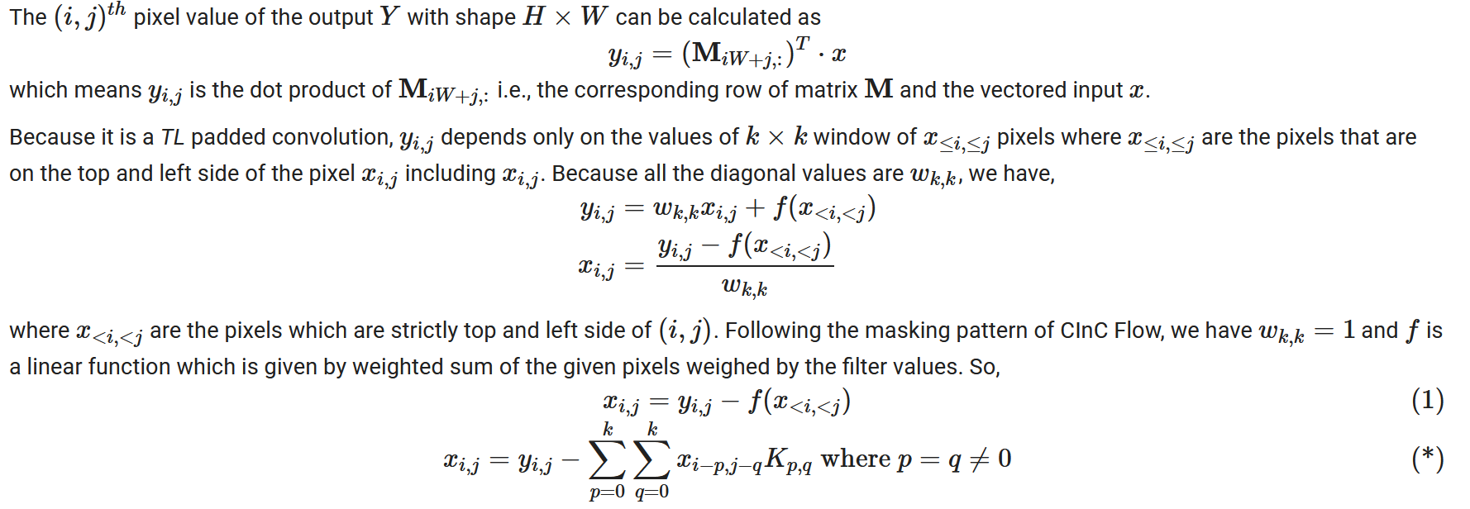
FInC Flow – Our Approach
Theorem 1: The inverse of the pixels on the diagonals of a TL padded convolution can be computed independently and parallelly
Proof:

Slide 56
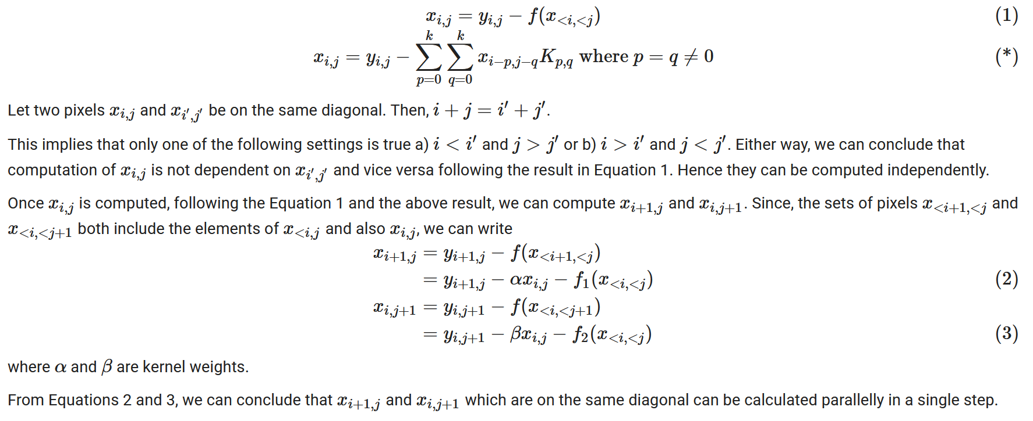
FInC Flow – Our Approach

Slide 57
FInC Flow – Our Approach
Theorem 1: The inverse of the pixels on the diagonals of a TL padded convolution can be computed independently and parallelly

Slide 58
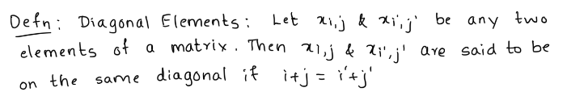
FInC Flow – Our Approach
Theorem 1: The inverse of the pixels on the diagonals of a TL padded convolution can be computed independently and parallelly

Slide 59
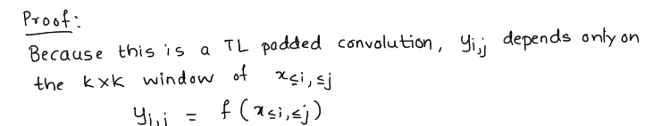
FInC Flow – Our Approach
Theorem 1: The inverse of the pixels on the diagonals of a TL padded convolution can be computed independently and parallelly

Slide 60
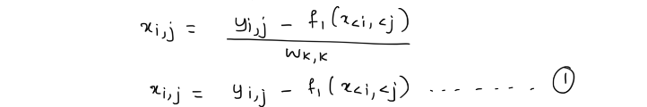
FInC Flow – Our Approach
Theorem 1: The inverse of the pixels on the diagonals of a TL padded convolution can be computed independently and parallelly

Slide 61
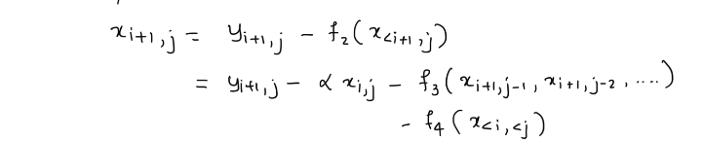





FInC Flow – Our Approach

Slide 62





FInC Flow – Our Approach

Slide 63
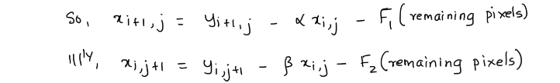
FInC Flow – Our Approach

Slide 64
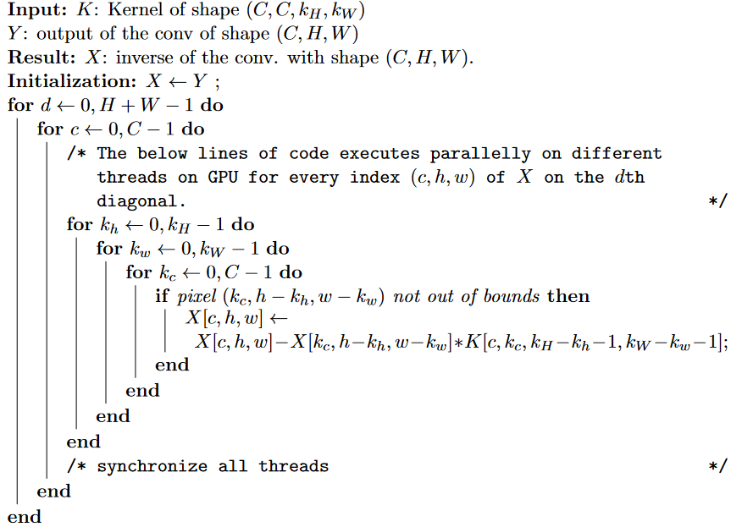
FInC Flow – Our Approach
Algorithm 1: Fast Parallel Inverse Algorithm for a TL Padded Convolution Block

Slide 65
FInC Flow – Our Approach
Theorem 2: Algorithm 1 uses only (H + W − 1)k² sequential operations.
Proof:
We have proved in Theorem 1 that the inverse of pixels on a single diagonal can be computed parallelly in one iteration of Algorithm 1. Since there are H + W − 1 number of diagonals in a matrix and there are at maximum k² entries in a row of the convolutional matrix, the number of sequential operations needed will be (H + W − 1)k².

Slide 66
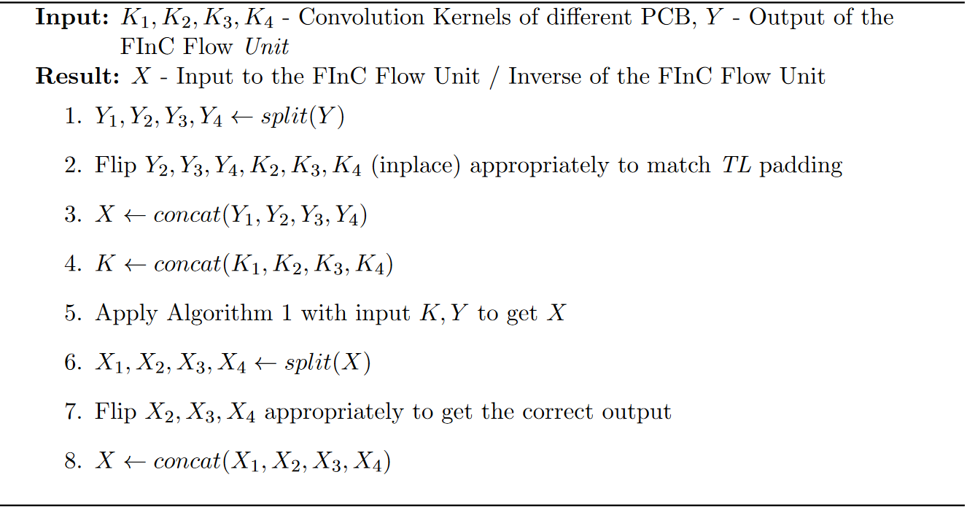
FInC Flow – Our Approach
Algorithm 2: Fast Inverse Algorithm for FInC Flow Unit

Slide 67
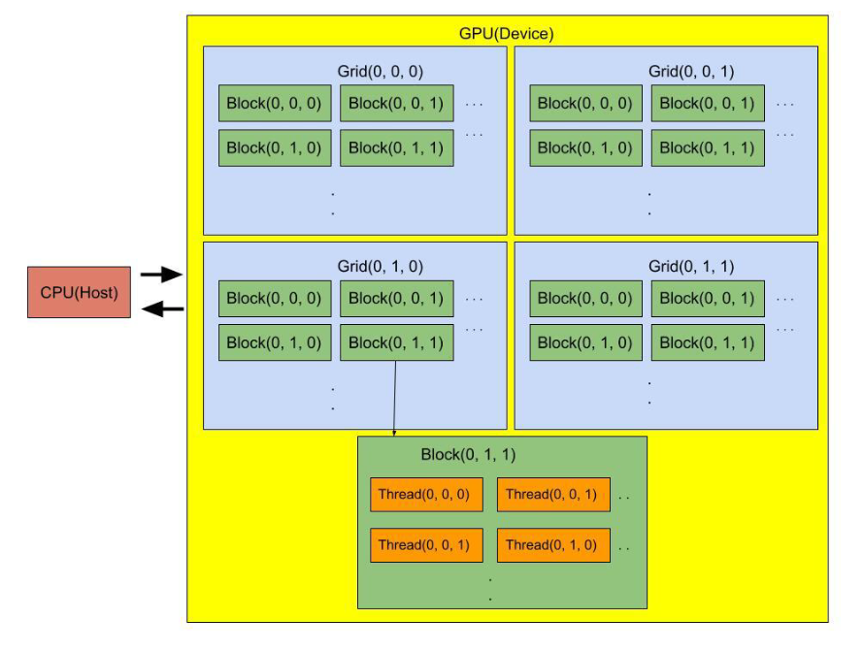
GPU (CUDA) - Architecture
CUDA Architecture

Slide 68
CUDA - Programming
A typical execution of a CUDA C/C++ code involves several steps like
1. Allocate memory on the host for input and output
2. Allocate memory on the device(GPU)
3. Copy data from host to device
4. Launch the kernel - CUDA function and execute it
5. Copy the results back to host
6. Free the memory on both the host and the device

Slide 69
CUDA - Programming
ThreadID Calculation Code
BlockID Calculation Code
Algorithm 1 Code: Link
Algorithm 2 Code: Link

Slide 70
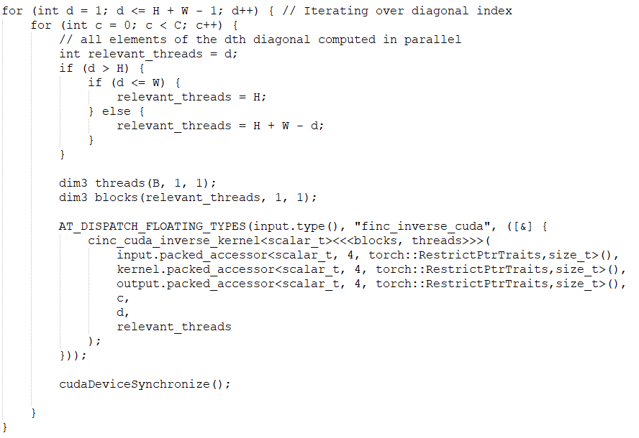
CUDA – Main Function

Slide 71
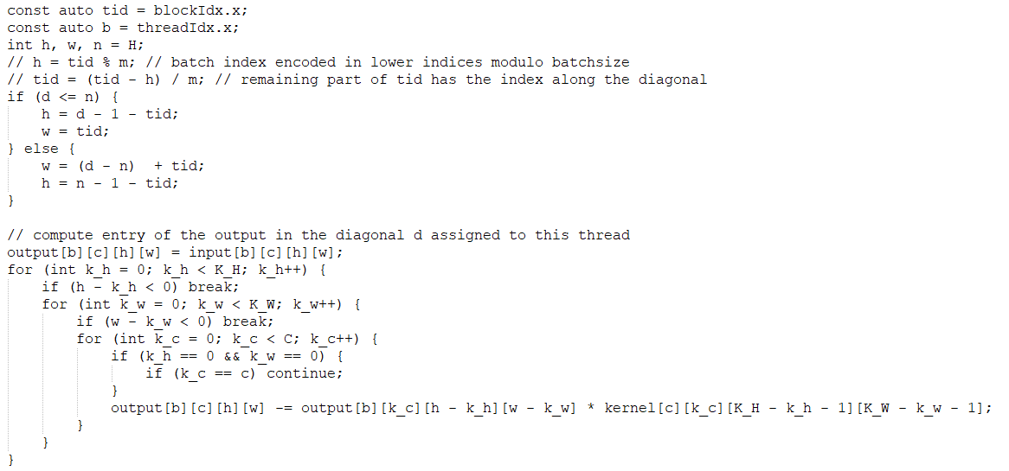
CUDA – Kernel

Slide 72
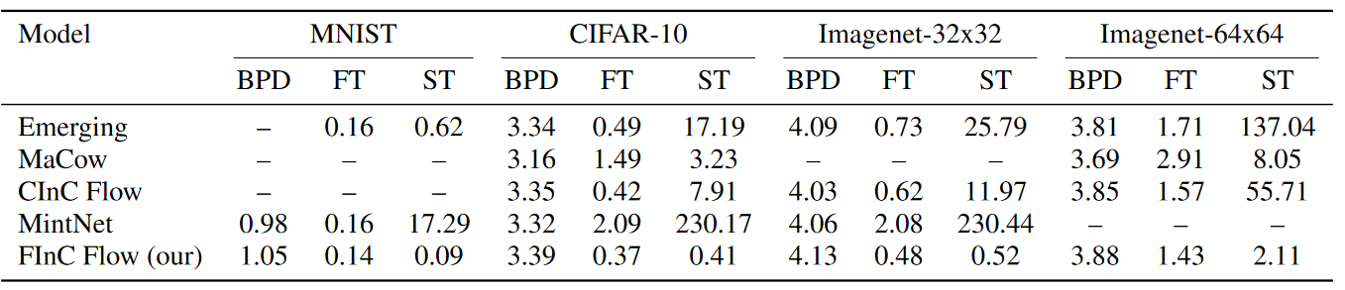
Results
Comparison of BPD, FT, ST with other Convolution Based Models
Datasets Used:
MNIST
CIFAR-10
Imagenet 32x32
Imagenet 64x64

Slide 73
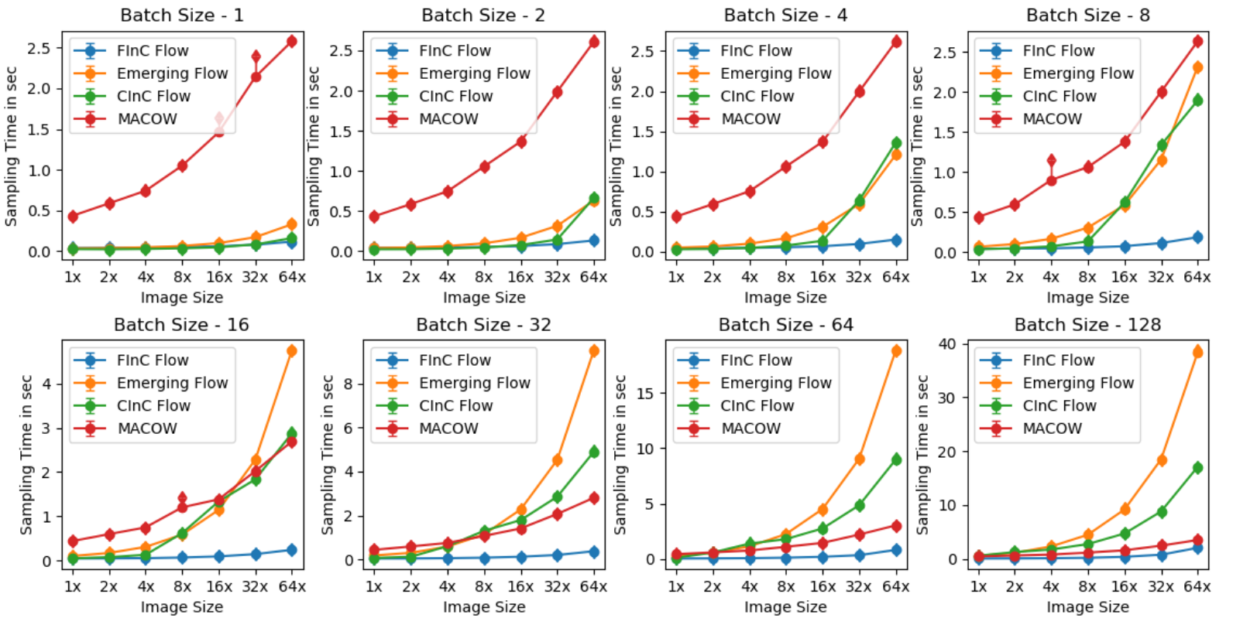
Results
Comparison of Sample Times with other models

Slide 74
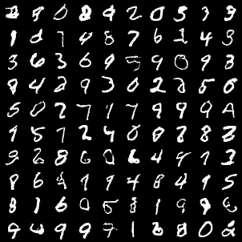
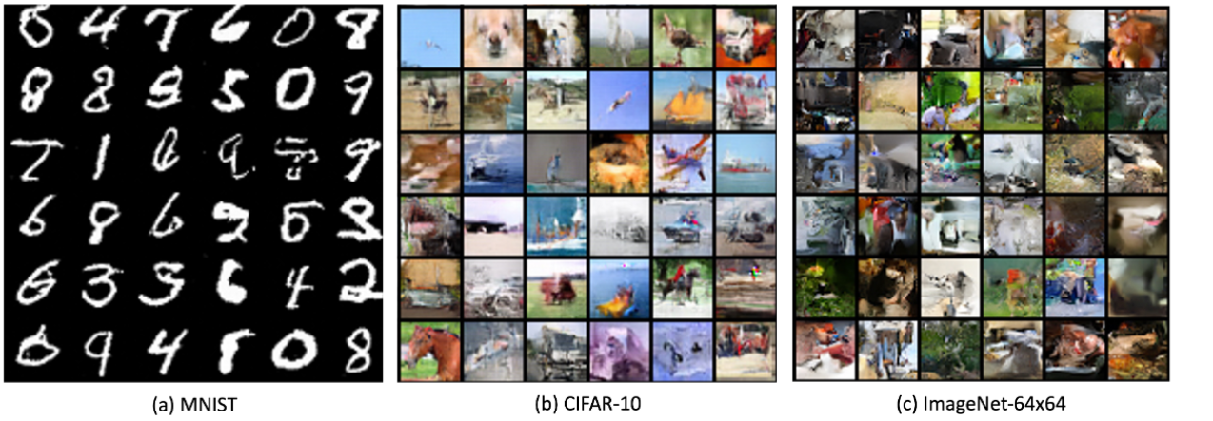
Results
Generate Samples

Slide 75
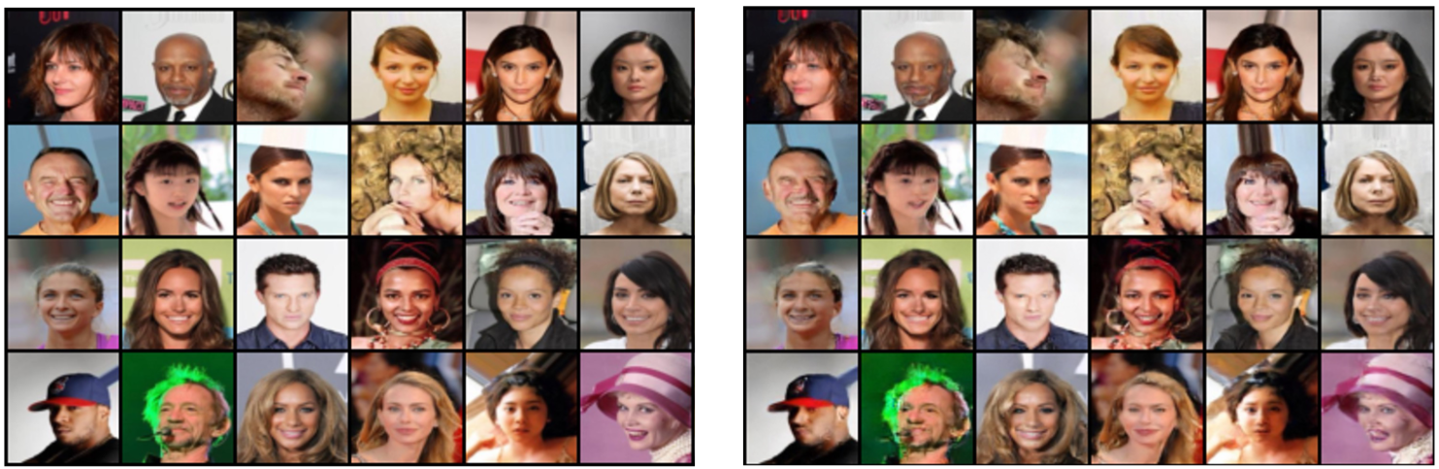
Results
Image Reconstruction
Input Images
Reconstructed Images

Slide 76
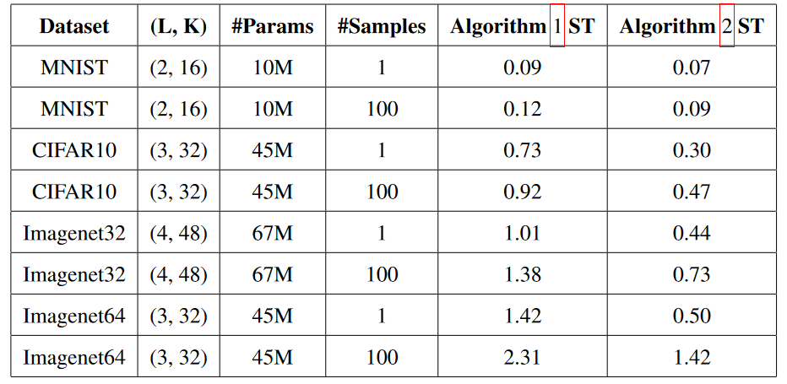
Results
Comparison of Algorithm 1 and Algorithm 2

Slide 77
Conclusion
With a parallel inversion approach, we present a k × k invertible convolution for Normalizing flow models. We utilize it to develop a model with highly efficient sampling pass, normalizing flow architecture. We implement our parallel algorithm on GPU and presented benchmarking results, which show a significant enhancement in forward and sampling speeds when compared to alternative methods for k × k invertible convolution

Slide 78

Any Questions?
https://github.com/aditya-v-kallappa/FInCFlow

Slide 79
References
Glow
Self Normalizing Flows
Real NVP
Wavelet Flow
Flowplusplus
NanoFlow
Emerging Flow
MaCow
CInC Flow
MintNet

